Slide 1
“One off Deals” Pre Order : While stock last – Separate order delivery in March 2023

Slide 2
EAM001205
Bahco Product Code S910
Pre-Order: While stocks last

Slide 3
EAM001194
Bahco Product Code S160
1/4 Square Drive
Pre-Order: While stocks last

Slide 4
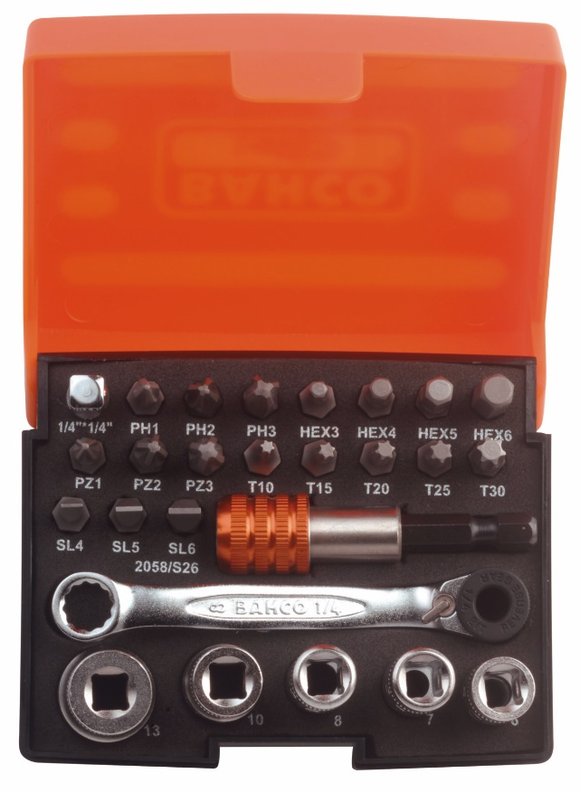
EAM001206
Bahco Product Code 2058/S26
Pre-Order: While stocks last

Slide 5
EAM001195
Bahco Product Code S106
Pre-Order: While stocks last

Slide 6
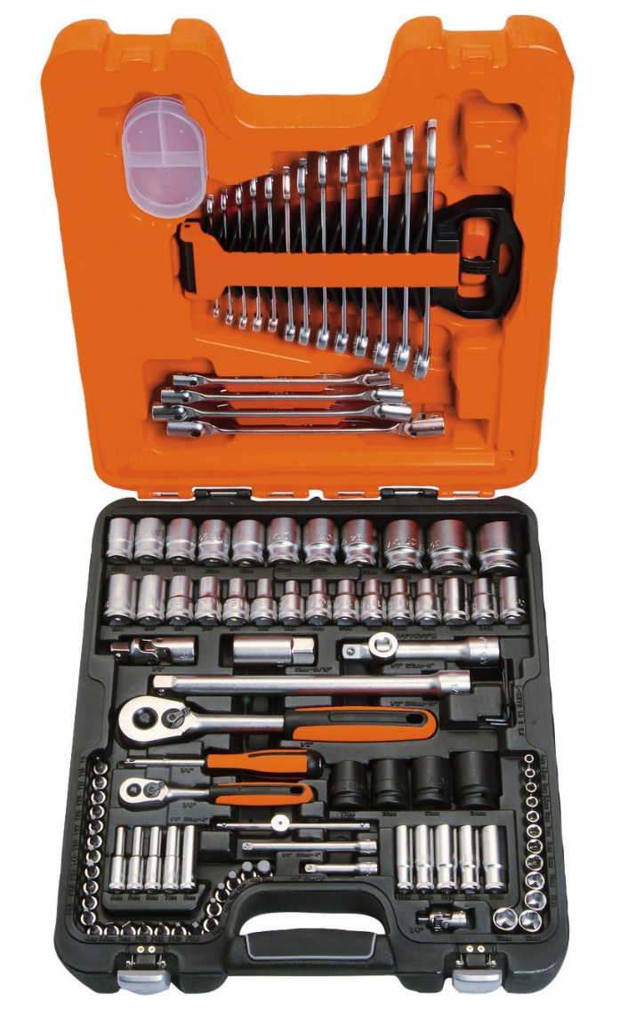
EAM001099
Bahco Product Code S108
Pre-Order: While stocks last

Slide 7
EAM001200
Bahco Product Code S138
Pre-Order: While stocks last

Slide 8
EAM001207
Bahco Product Code
S87+7
Pre-Order: While stocks last

Slide 9
EAM001208
Bahco Product Code S240
Pre-Order: While stocks last

Slide 10
EAM001209
Bahco Product Code S330
Pre-Order: While stocks last

Slide 11
EAM001210
Bahco Product Code SBSL25
Pre-Order: While stocks last

Slide 12
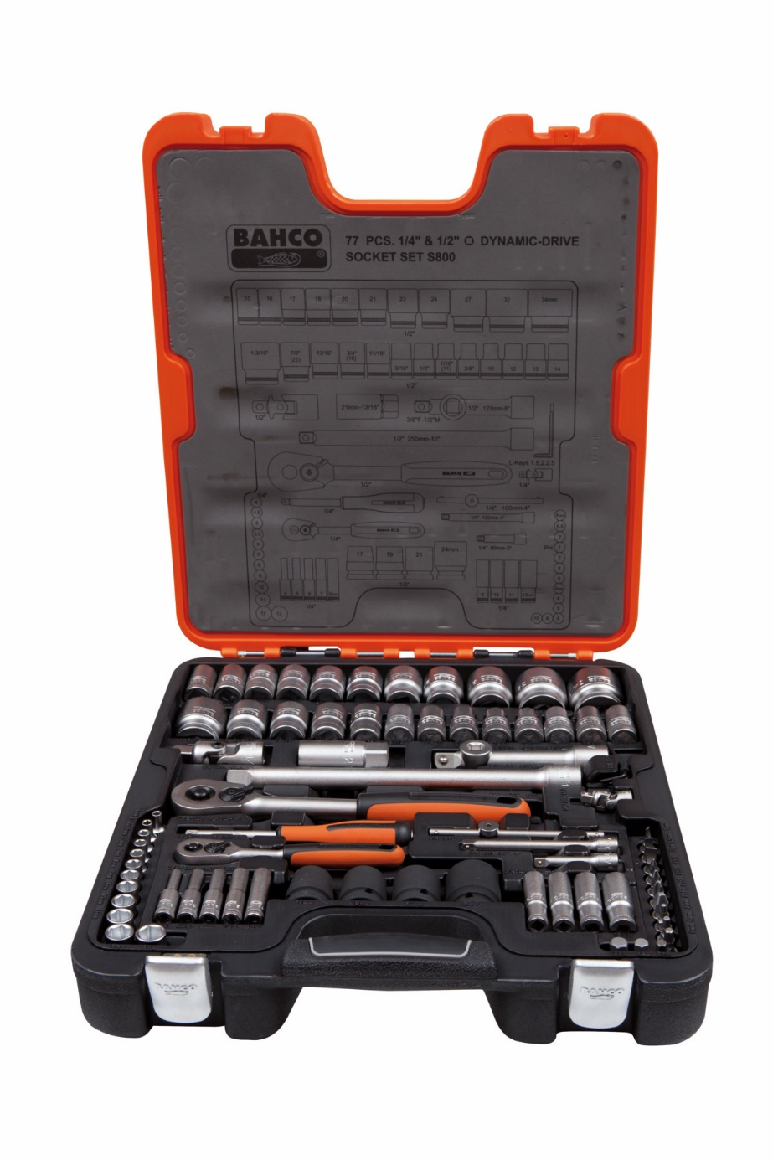
EAM001201
Bahco Product Code S800
Pre-Order: While stocks last

Slide 13
EAM001211
Bahco Product Code SL25L
Pre-Order: While stocks last

Slide 14
EAM001064
Bahco Product Code S400
Pre-Order: While stocks last

Slide 15
EAM001100
Bahco Product Code S410
Pre-Order: While stocks last

Slide 16
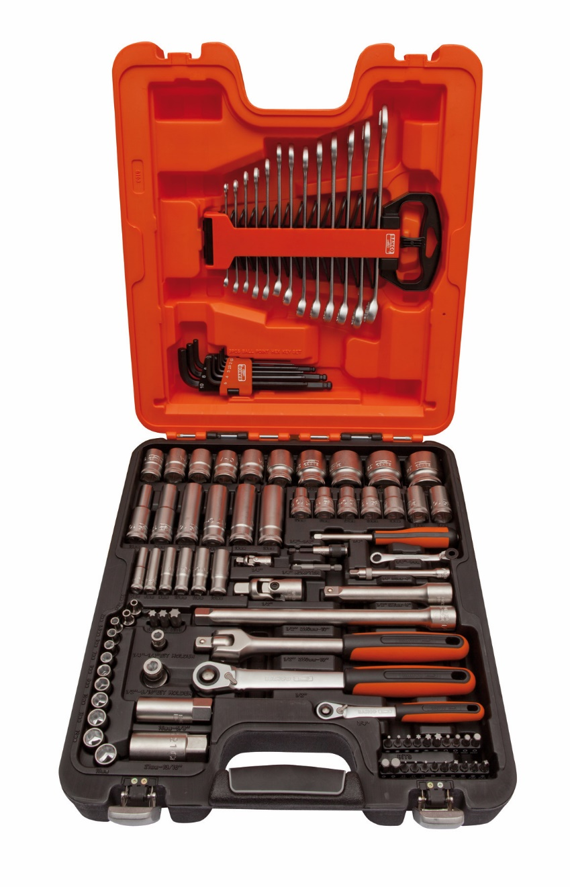
EAM001202
Bahco Product Code S103
Pre-Order: While stocks last

Slide 17
EAM001212
Bahco Product Code S560
Pre-Order: While stocks last

Slide 18
EAM001213
Bahco Product Code S290
Pre-Order: While stocks last

Slide 19
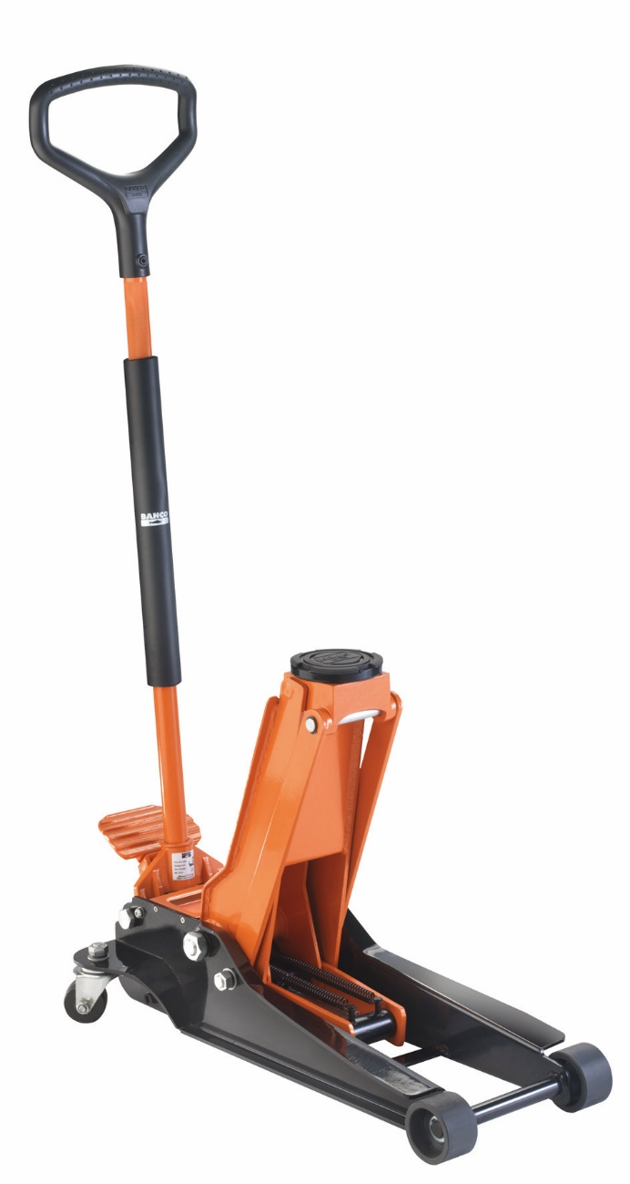
EAM001214
Bahco Product Code BH13000
Pre-Order: While stocks last

Slide 20
EAM001203
Bahco Product Code BH1EU3000
Pre-Order: While stocks last

Slide 21
EAM001204
Bahco Product Code BH33000
Pre-Order: While stocks last

Slide 22
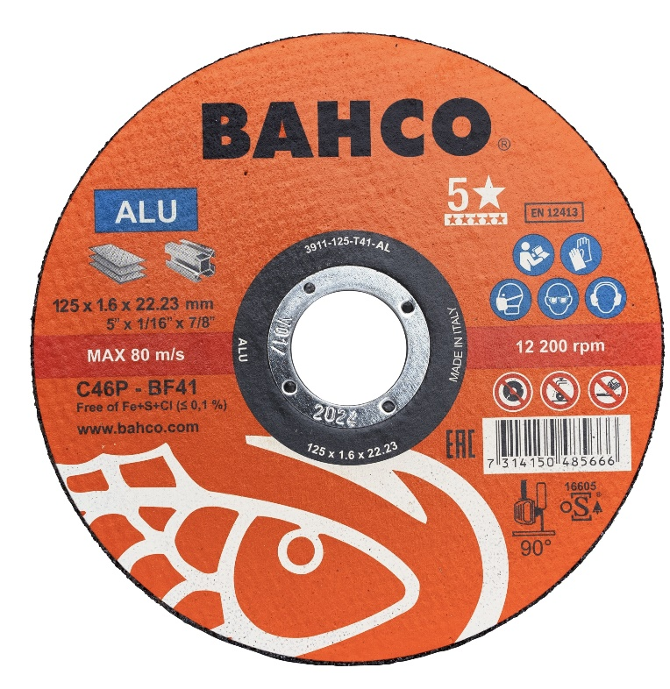
EAM001125
Bahco Product Code
3911-115-IM-10P
Pre-Order: While stocks last

Slide 23
EAM001017
Bahco Product Code
59/S54BC-IP
Pre-Order: While stocks last

Slide 24
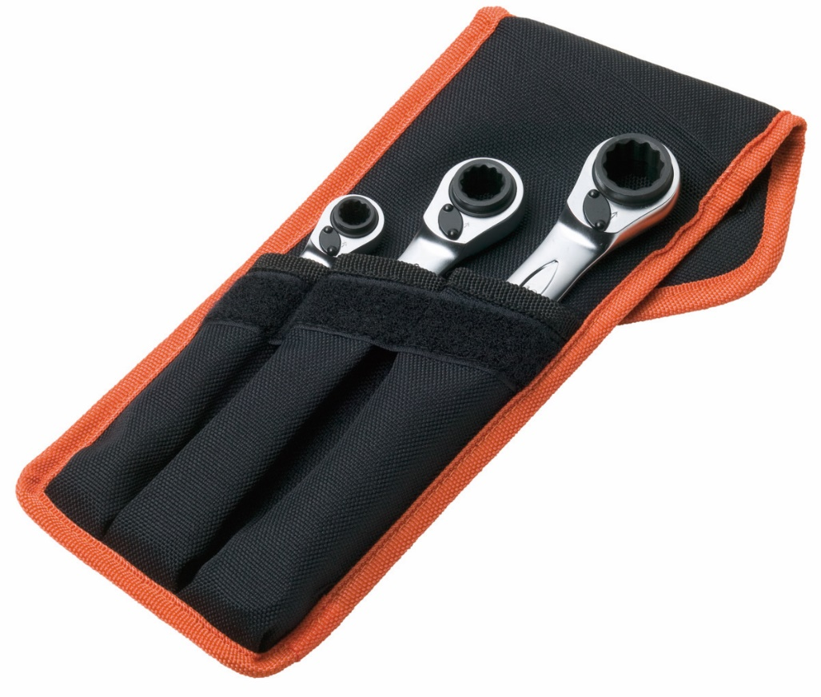
EAM001215
Bahco Product Code
S4RM/3T

Slide 25
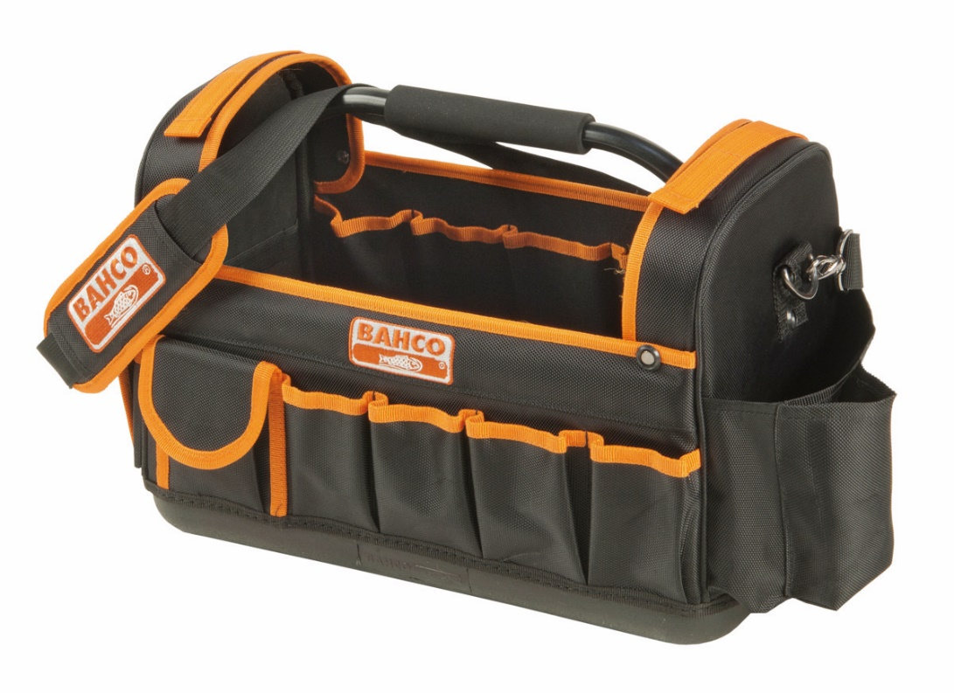
EAM001216
Bahco Product Code
3100TB
Pre-Order: While stocks last

Slide 26
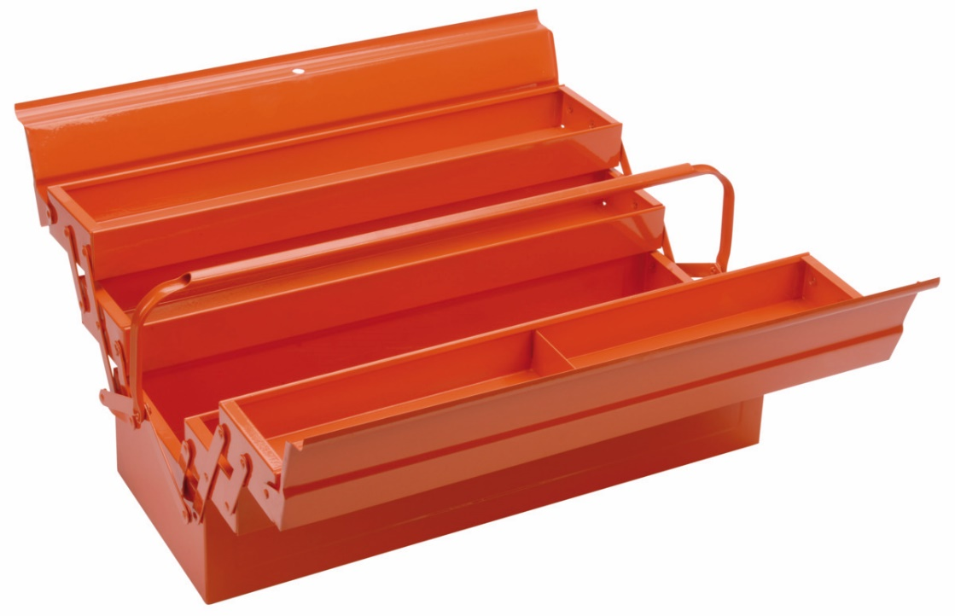
EAM001217
Bahco Product Code
3149-OR
Pre-Order: While stocks last

Slide 27
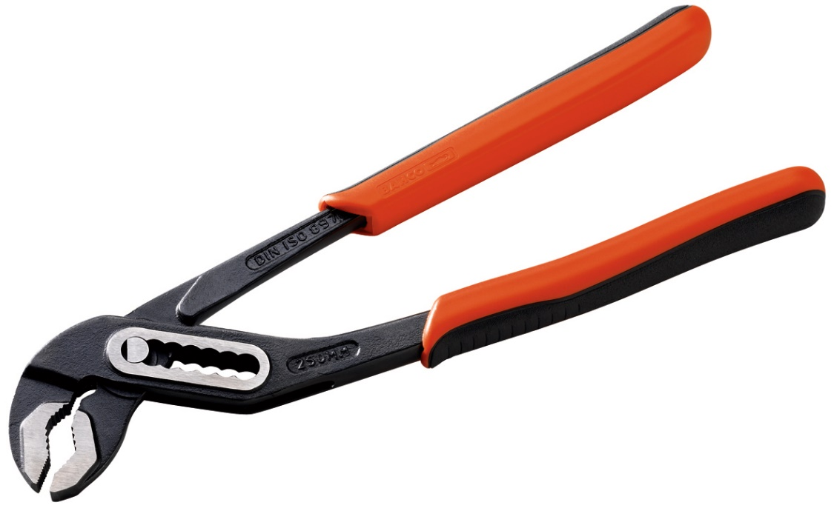
EAM001218
Bahco Product Code
2971G-250
Pre-Order: While stocks last

Slide 28
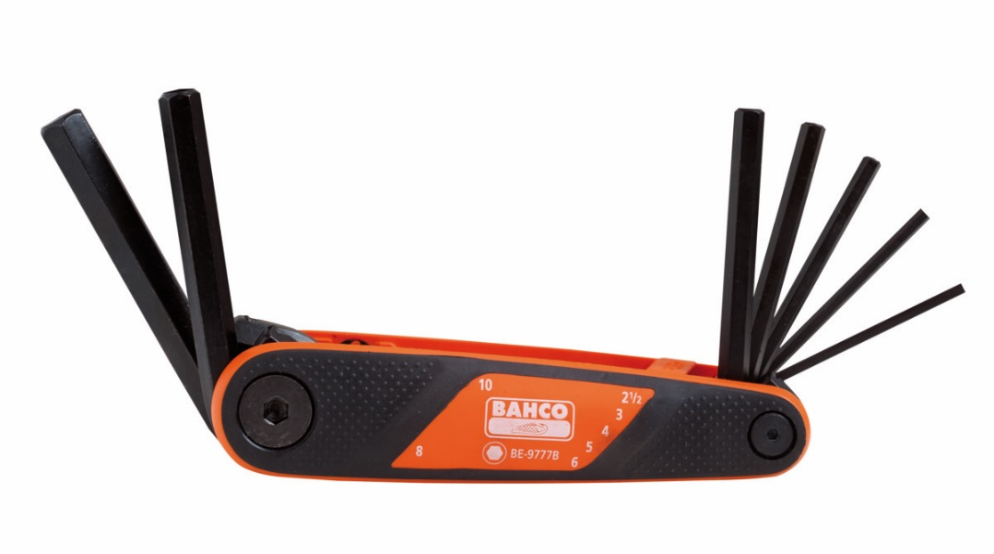
EAM001219
Bahco Product Code
BE-9777B
Pre-Order: While stocks last

Slide 29
EAM001196
Bahco Product Code MA431
Pre-Order: While stocks last

Slide 30
EAM001220
Bahco Product Code
MA421
Pre-Order: While stocks last

Slide 31
EAM001221
Bahco Product Code MA401
Pre-Order: While stocks last

Slide 32
EAM001048
Bahco Product Code MA411
ORDERS DIRECT TO MYSELF ONLY

Slide 33
EAM001197
Bahco Product Code
1472K5
Pre-Order: While stocks last

Slide 34
EAM001198
Bahco Product Code
1472K5BKFF2SD
Pre-Order: While stocks last

Slide 35
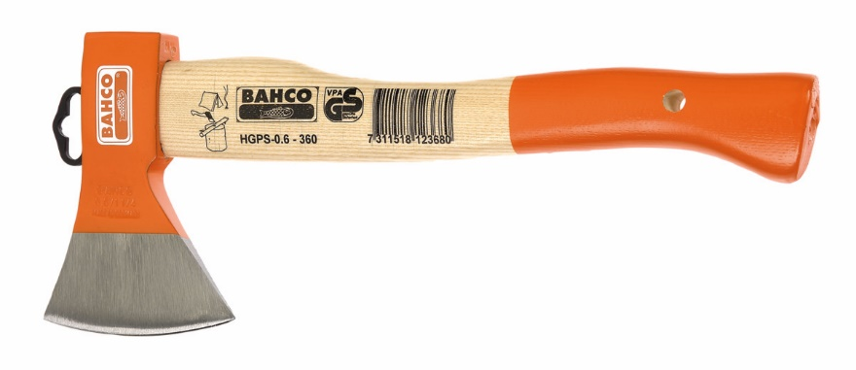
EAM001222
Bahco Product Code
HGPS-0.6-360
Pre-Order: While stocks last

Slide 36
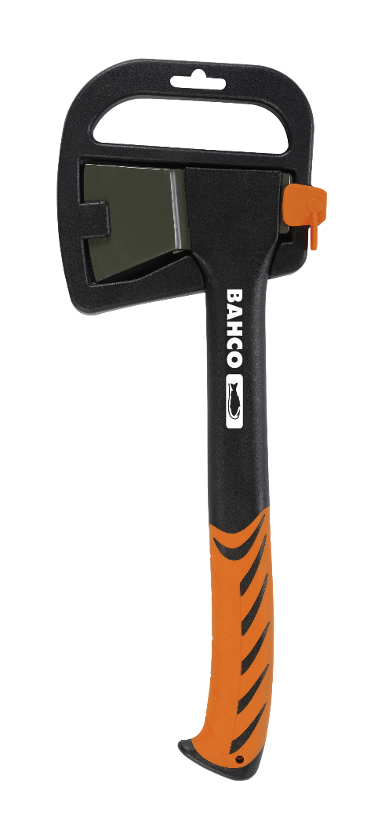
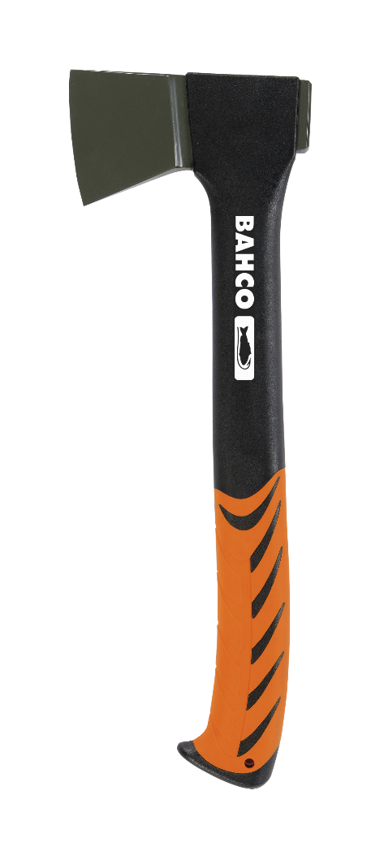
EAM001199
Bahco Product Code
CUC-0.4-360
Pre-Order: While stocks last

